Slide 1
Flexible ASIC-based OpenFlow pipeline
Shaun Wackerly, HPE Aruba <wackerly@hpe.com>

Slide 2
Overview
Flexible ASIC tables
Tools
ovs2json
pipeline constructor
How it’s done in FAUCET

Slide 3
Flexible ASIC tables
HPE Aruba 6th generation ASIC
5400Rv3
3810
2930
Table types
TCAM, wildcardable (up to 8K entries)
Hash, exact-match (up to 64K entries)
Reconfigure pipeline at run-time
No reboot, OF disable, firmware change, or licensing needed

Slide 4
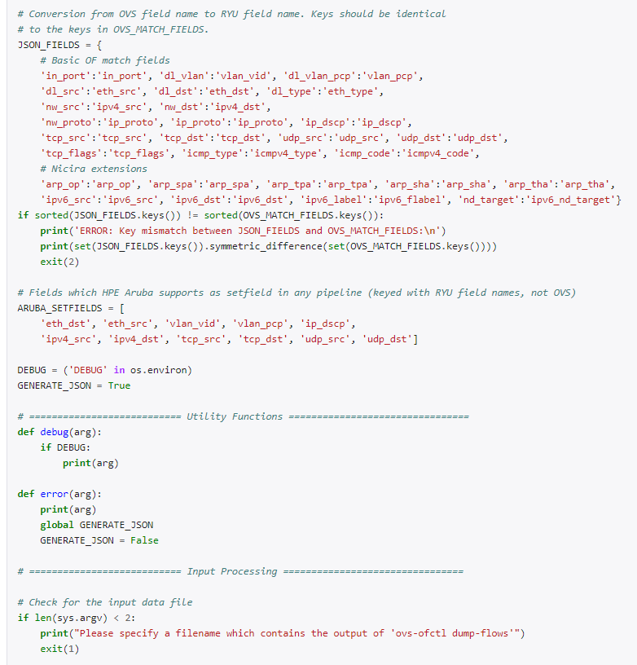
Tool: ovs2json
Read flows from OVS
extract match fields & entry counts
produce JSON pipeline definition
Use case
have existing application or solution implemented virtually (OVS)
want to deploy on HPE Aruba switches for scale/performance

Slide 5
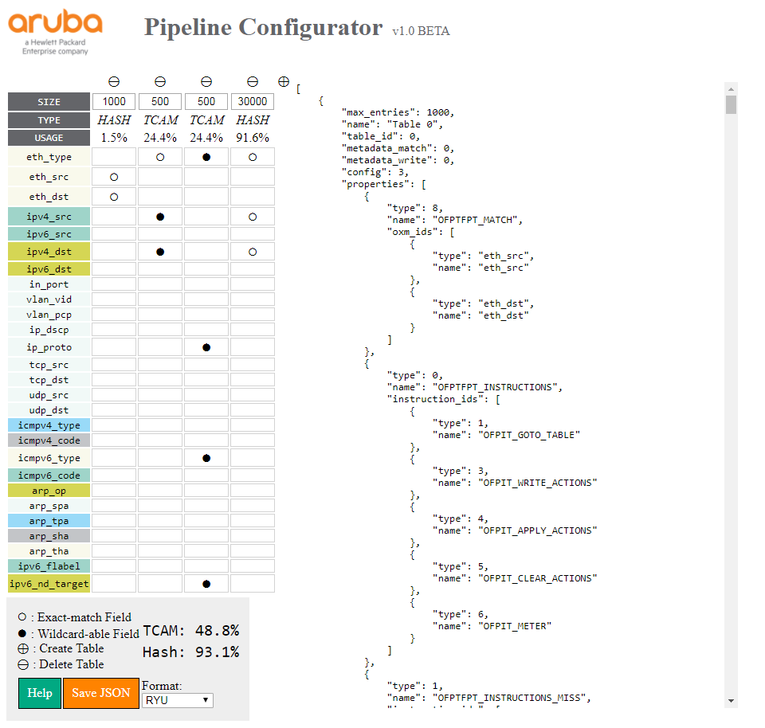
Tool: Pipeline constructor
Construct pipeline via GUI
table size
table ordering
match fields/type
All actions are automatically included
Use case
have idea for application
want to speculate if implemented (at scale) on an HPE Aruba switch

Slide 6
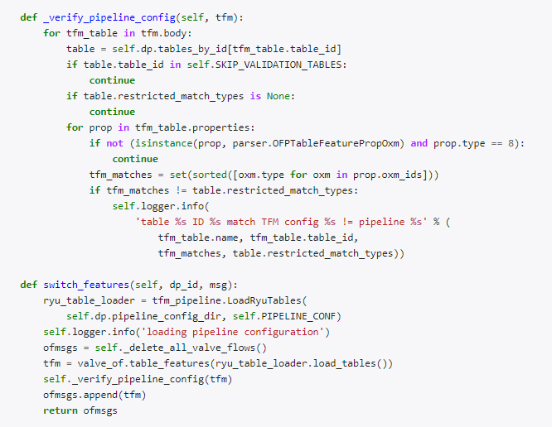
How it’s done in FAUCET
OFPMP_TABLE_FEATURES request**
Empty body: Read pipeline
Full body: Define pipeline
In the code:
faucet/valve.py – Identifies switch type, verifies pipeline
faucet/tfm_pipeline.py - Parse JSON & define pipeline
Parse JSON file (LoadRyuTables.load_tables)
Send to switch (valve_of.table_features)
** OpenFlow 1.3.5 spec, section 7.3.5.5

Slide 7
Thank you
Shaun Wackerly, HPE Aruba <wackerly@hpe.com>

